Slide 1

Predicting sales revenue of ecommerce sales data using machine learning algorithms.
Mukesh M Vadapalli
C00246445
MSc DataScience
Prof- Dr Greg Doyle
Arima and regression algorithms

Slide 2
Research question
Is the performance of the time series machine learning ARIMA model depends on the size(date range) of the sales dataset to predict future revenue?
Can we create a machine learning model framework that can predict future sales revenue? If yes what is the best model, ARIMA or regression to use for prediction?

Slide 3
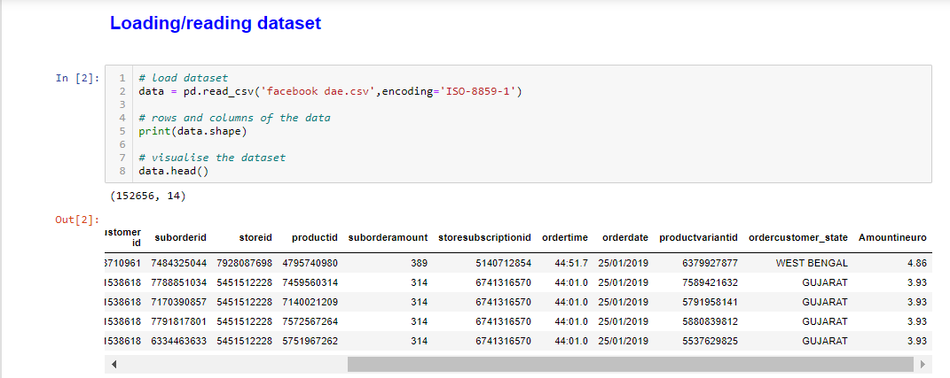
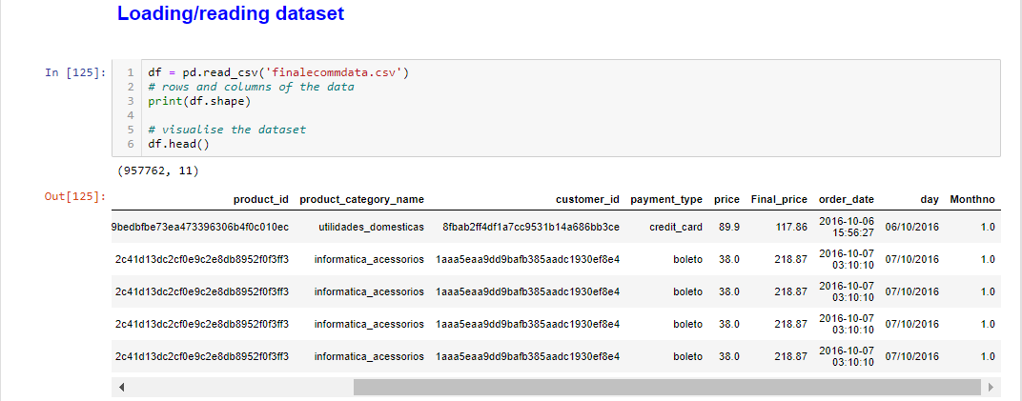
Dataset
1- Smaller dataset(11 Months)
Smaller dataset is the eCommerce sales data collected from my previous company. Data includes the sales from march 2018 to january 2019.
152656 rows and 14 columns.
2- Larger dataset(21 Months)
Larger dataset is the eCommerce sales data of Brazilian company (Olist) collected from GitHub datasets. Data includes the sales from October 2016 to august 2018.
190634 rows and 11 columns.

Slide 4
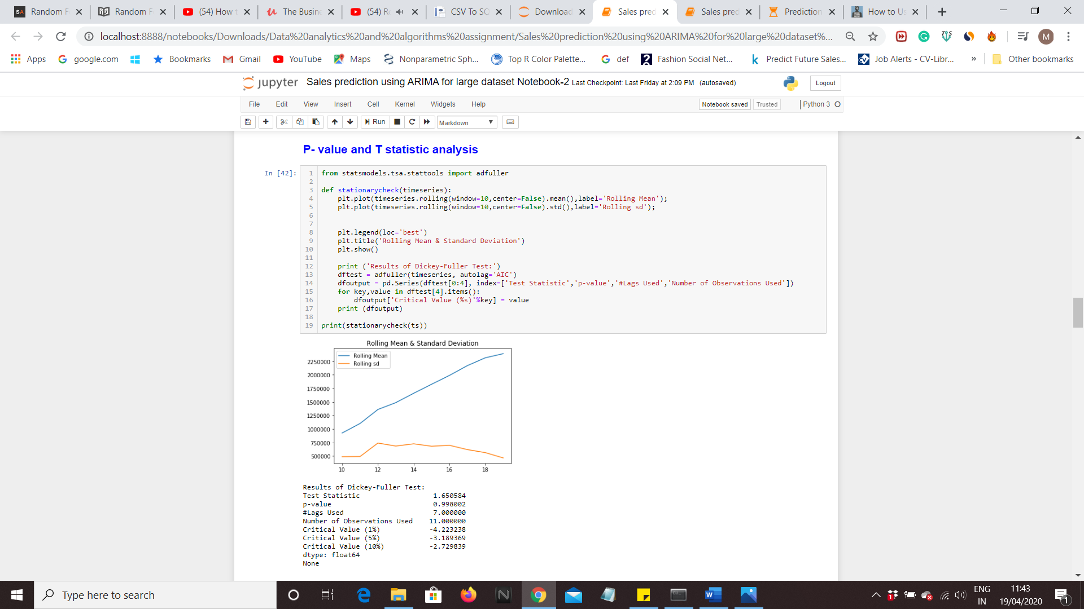
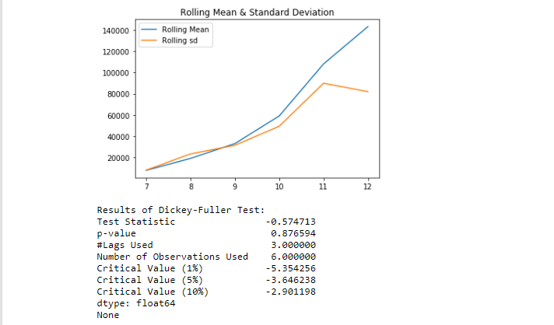
Time series (ARIMa) analysis To check the stationarity of timeseries data, ADF(Augmented Dicky Fuller) test is performed. The ADF test comprises of a test statistics, probability value and 3 critical values for difference confidence levels.
Data is said to be stationary if:-
P-value should be less than alpha value 0.05 (to reject the null hypothesis(H0), i.e. the data does not have a unit root and is stationary.
If t-statistic is less than the critical value, we can say that time series is stationary.
Mean is not constant as it is changing with the time
p-value(0.87) is > 0.05: Fail to reject the null hypothesis and data is not stationary.
T-statistic(-0.5747) is bigger than the critical values(-5.3542,-3.6462,-2.9011) so no stationary.
p-value is > 0.05: Fail to reject the null hypothesis and data is not stationary.
T-statistic(1.6505) is bigger than the critical values(-4.223238,-3.1893,-2.7298) so no stationary.

Slide 5
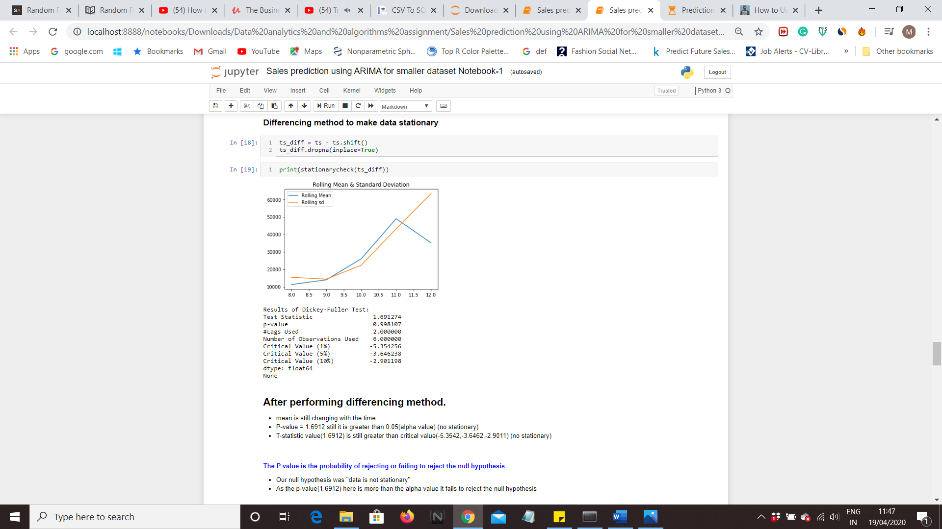

Time series (ARIMa) analysis-
After Transforming
Mean is still changing with the time.
P-value = 0.99 still it is greater than 0.05(alpha value) (no stationary)
T-statistic value(1.6912) is still greater than critical value(-5.3542,-3.6462,-2.9011) (no stationary)
P-value = 0.00184 is smaller than 0.05(alpha value) (stationary)
* T-statistic value(-3.93212) and is smaller than critical value(-4.231573,-3.182950,-2.728700) (stationary)
* As the test statistic is smaller than the 5% critical values so we can say with 95% confidence that this is a stationary series

Slide 6
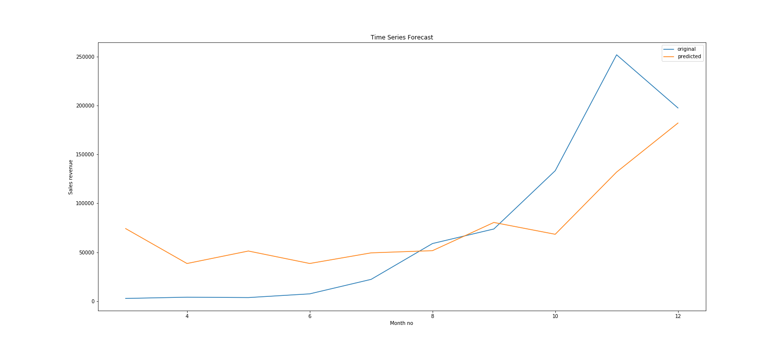
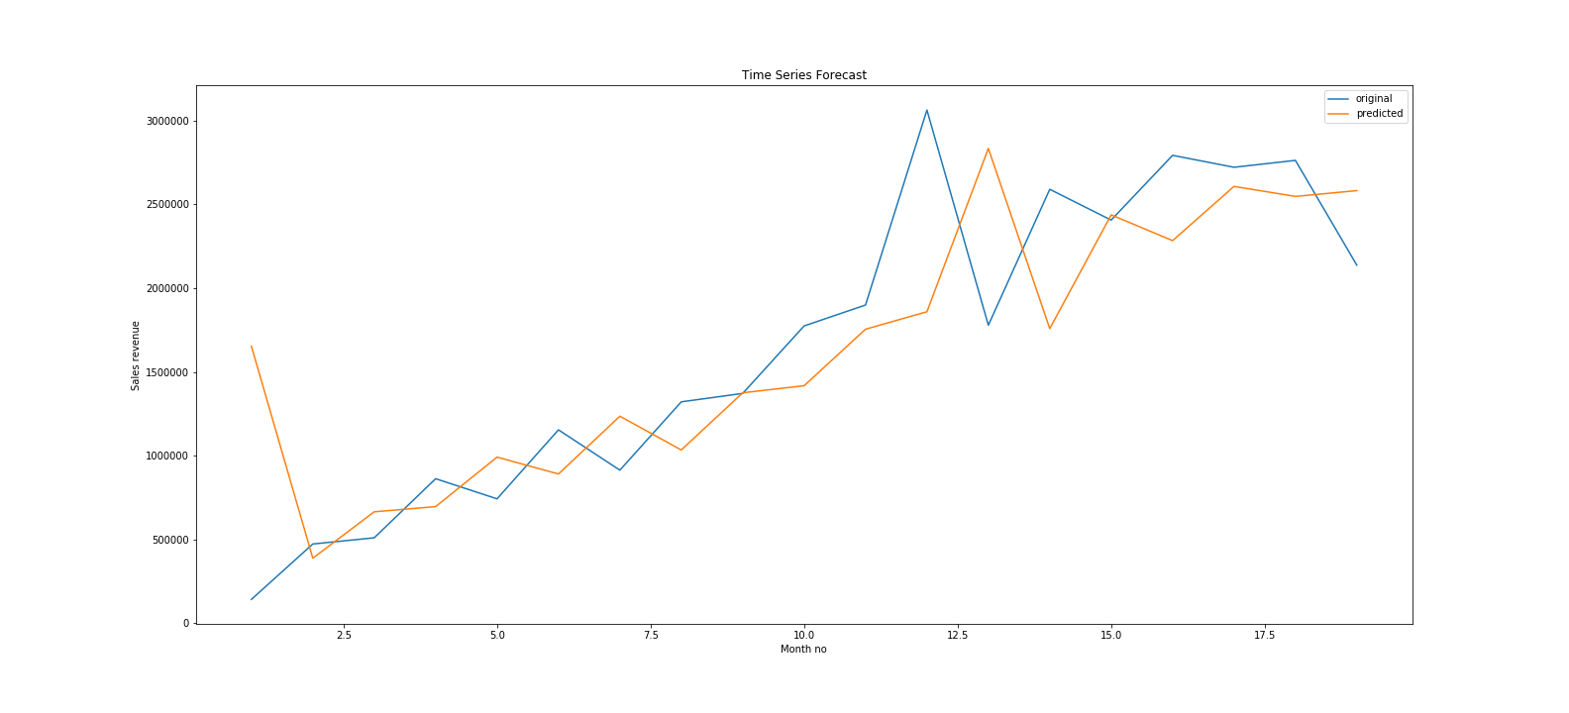
Applying time series arima (AutoRegressive Integrated Moving Average) model
AIC(The Akaike Information Critera) is used to select p(AR) and q(MA) values.
model2 = ARIMA(ts, order=(0,0,1))
model2 = ARIMA(ts, order=(1,0,0))
Forecast=model_fit2.forecast(steps=*)[0]
To forecast the future values.

Slide 7
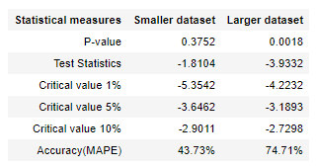
Results
Time-series machine learning ARIMA model is performed on both the dataset(smaller and larger).
- P-value for the smaller dataset is high as compared to alpha value and it failed to reject the null hypothesis i.e. data is not stationary, whereas p-value for the larger dataset is low compared to alpha value and it rejected the null hypothesis.
-Sample size and degree of impact, influences a P-value and test value. Larger sample sizes reduces the impact of random error also the overall variability is decreased and measures become more precise.
-Test value for smaller dataset is large as compared to all the critical value while test value for larger dataset is approximately equal to 1% critical value and less than 5% and 10% critical values so we can say with 99% confidence interval that the data is stationary.
-Accuracy for larger dataset is 74.71% and smaller dataset is 43.73%

Slide 8
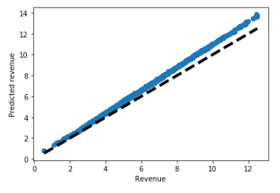
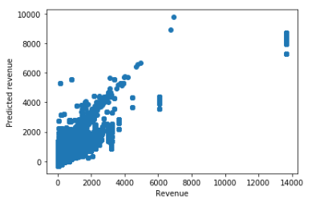
Predicting revenue using regression models.
Prediction for my previous company data
R-squared value-0.849
For predicting sales revenue, five regression algorithms are applied on both smaller and larger dataset. Ensemble machine learning model is used as it enhances the performance and accuracy of the model.
Five ML regression models used are:
Lasso
Ridge
XGBoost
Lightgbm
Elasticnet
Stackgen- It is used to combine multiple regression models with a meta-regressor.
Prediction for Brazilian ecommerce data
R-squared value-0.774

Slide 9
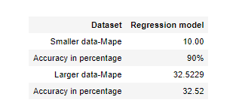
Result for regression model
Accuracy of smaller dataset is 90%.
Accuracy of larger dataset is 32.52%.
Larger data has few repetitive values in large numbers in dependent variable(Y_train) and this values cannot be dropped as it will reduce the size of the dataset and such cases happens in real business scenario.
Even After applying box cox and log transformation to normalize the revenue column, values get converted to nan, infinite which was not in an appropriate format to apply ml algorithms.

Slide 10
Conclusion:
To predict/forecast sales revenue of ecommerce data, time-series and regression models has been applied.
Larger data set gave good accuracy as compared to smaller dataset in time-series analysis.
Time-series approaches for sales forecasting has limitations, such as it needs to have historical data for a long time period to capture seasonality.
Regression algorithms captures the patterns which exist in the whole set of stores or products to predict future sales.
Hence, sales prediction is rather a regression problem than a time series problem as we can find complicated patterns in sales dynamics and it is independent of size and shape of the dataset.
Whereas to forecast future sales, it is simple using time-series ARIMA model as it requires only two column price and daterange.

Slide 11
Thank you

